Slide 1
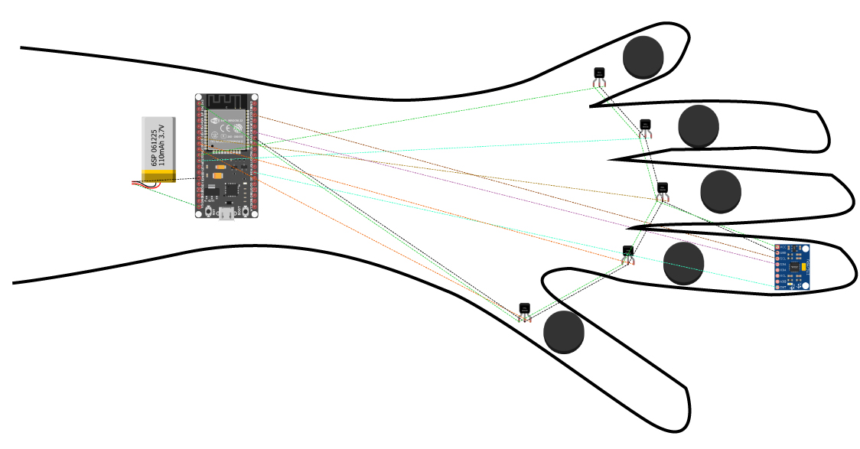
CYBER GLOVE
Gesture Recognition System
Using LSTM Neural Networks & IMU Sensors
A wearable device for real-time hand gesture classification

Slide 2
Problem Statement
With the increasing demand for intuitive human-computer interaction,
traditional input devices limit natural expression and accessibility.
Objectives:
A) Capture real-time motion data (accelerometer + gyroscope) from the glove
B) Process time-series sensor data into structured ML input
C) Train LSTM models to classify gestures (alphabets A, B, C, etc.)
D) Convert recognized gestures into usable outputs (text, commands)
Key Challenges:
A) Handling noisy sensor data and ensuring proper calibration
B) Maintaining temporal consistency in gesture recognition
C) Achieving high accuracy with limited training data
D) Ensuring real-time performance on resource-constrained hardware
End Goal: Build a functional Cyber Glove prototype that acts as a
virtual input device, replacing or augmenting traditional interfaces.

Slide 3
Literature Review / Related Work
1. Sensor-Based Sign Language Recognition (MDPI Sensors, 2022)
Smart glove with IMU + flex sensors; BiLSTM achieved 96% accuracy.
2. EWBiLSTM-ATT Model (IEEE Access, 2023)
Expanded Wide-kernel CNN + BiLSTM + Attention mechanism for SLR.
3. CNN-BiLSTM Architecture (PLoS ONE, 2023)
CNN for spatial features, BiLSTM for temporal, Attention for weighting.
4. Para-LSTM-CNN (IEEE Sensors Journal, 2022)
Parallel processing of spatial/temporal features from IMU data.
5. Real-Time Embedded LSTM on STM32 (IEEE ICRA, 2021)
Deployed optimized LSTM on MCU with <50ms latency.
6. Transfer Learning for Sensor Displacement (IEEE, 2023)
Fine-tuning models robust to glove repositioning across users.
7. Kalman Filter + LSTM Fusion (Elsevier, 2022)
Complementary filter preprocessing before LSTM classification.

Slide 4
Abstract
This project presents the design and development of a Cyber Glove — a
wearable gesture recognition system that captures hand motion using an
MPU9250 (currently MPU6050) 9-axis IMU sensor connected to an ESP32
microcontroller.
The sensor outputs 6D time-series data (3-axis accelerometer + 3-axis
gyroscope) at 100 Hz, stored as CSV files where each file represents
one gesture sample (approximately 300 timesteps × 6 features).
We explore 5 LSTM model configurations:
• Raw 6-channel input
• Normalized 6-channel input
• Madgwick-filtered 4-channel quaternion input
• Combined 10-channel (raw + quaternion) input
• Normalized 10-channel input
The final system aims to work in real-time:
Capture motion → Preprocess → Predict gesture → Map to keyboard input.

Slide 5
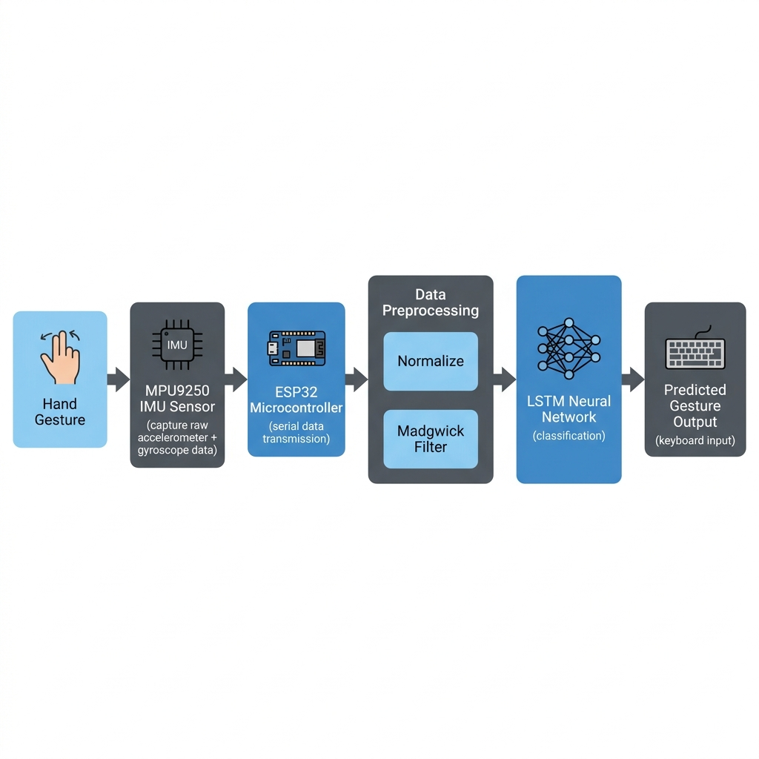
Methodology

Slide 6
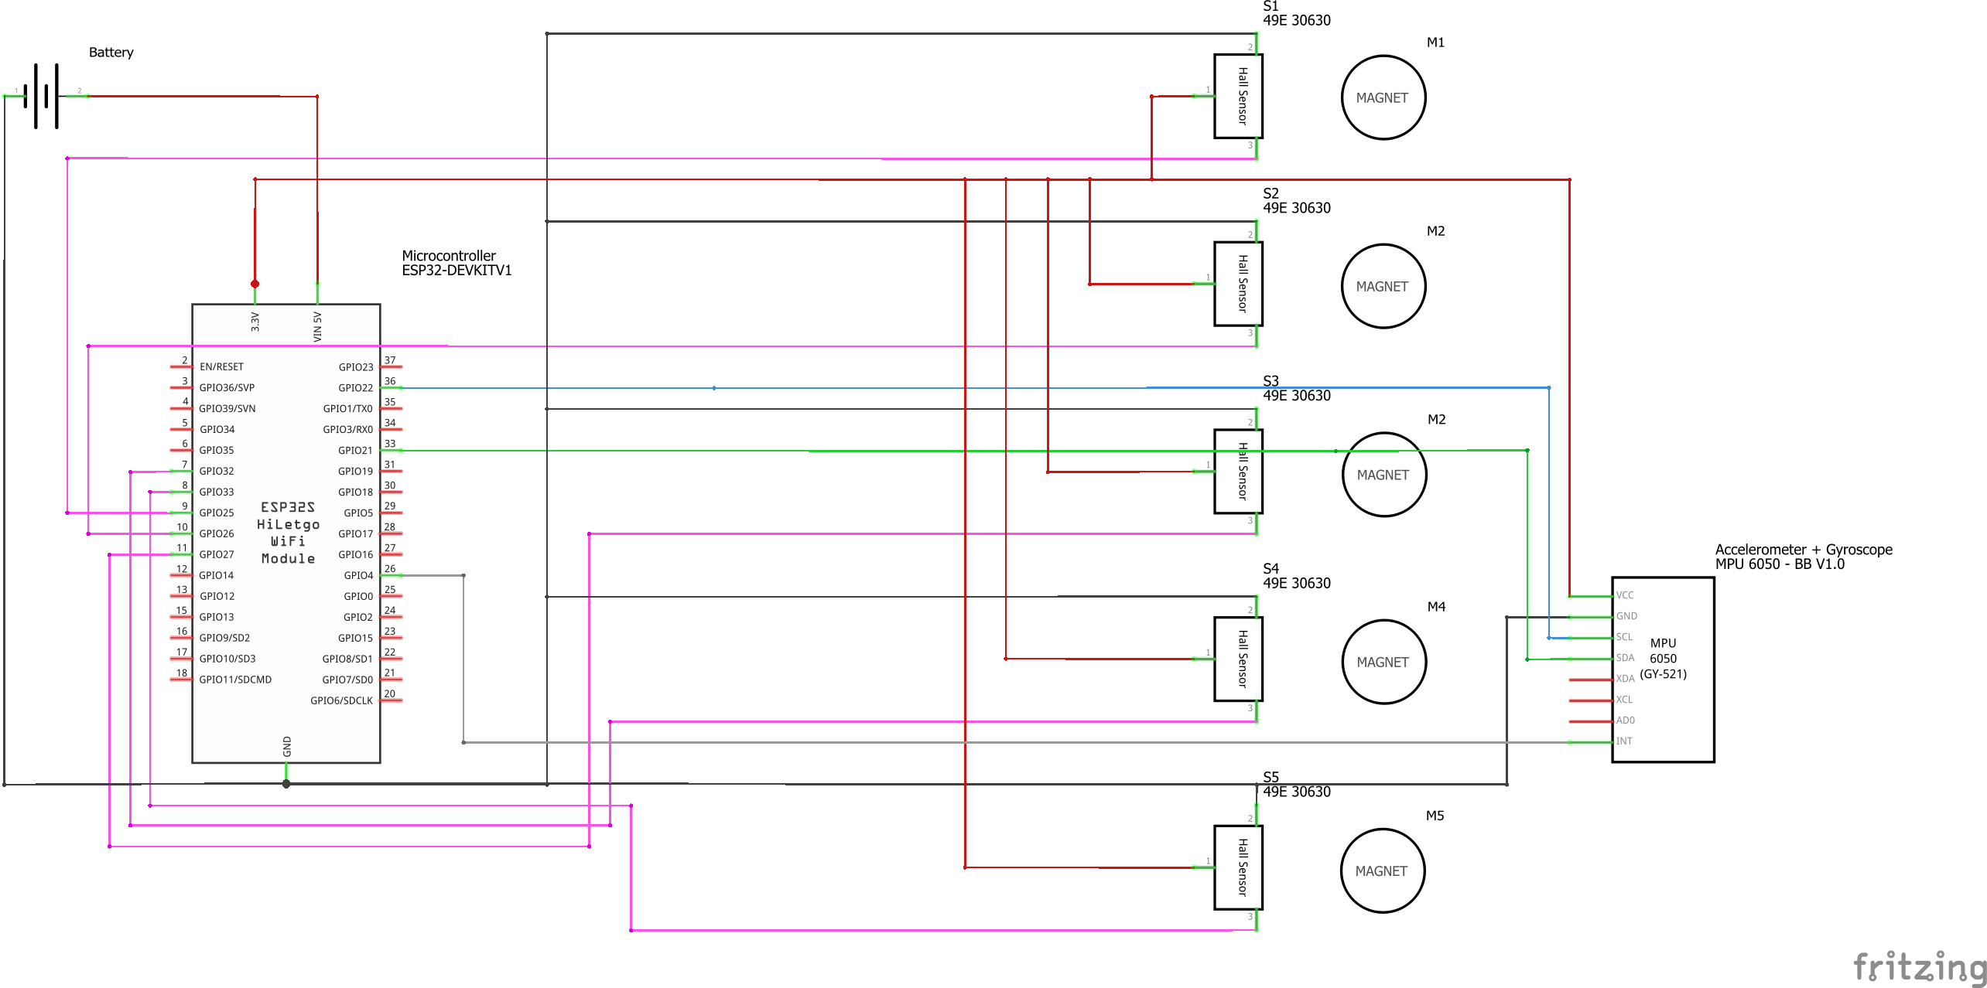
Tech Stack
Hardware:
• ESP32 HiLetgo WiFi Module (Dual-core Xtensa LX6)
• MPU6050 IMU Sensor (upgrading to MPU9250)
• 49E 30630 Hall Effect Sensors × 5
• Magnets × 5
• LiPo Battery 3.7V 110mAh
Software:
• Python 3.10 + PyTorch 2.x
• AHRS library (Madgwick filter)
• scikit-learn (metrics & evaluation)
• Arduino IDE (ESP32 firmware)
Communication:
• Serial / Bluetooth for data transmission

Slide 7
ESP32 — Microcontroller Overview
Parameter | Specification
Processor | Dual-core Xtensa LX6, up to 240 MHz
SRAM | 520 KB
Flash | 4 MB (external)
WiFi | 802.11 b/g/n, 2.4 GHz
Bluetooth | v4.2 BR/EDR + BLE
GPIO | 36 programmable pins
ADC | 12-bit SAR, 18 channels
I2C / SPI / UART | 2 / 3 / 3 interfaces
Operating Voltage | 2.2V – 3.6V
Temperature Range | -40°C to +125°C

Slide 8
MPU9250 — 9-DoF IMU Sensor
The MPU-9250 is a multi-chip module by InvenSense (TDK) integrating:
• 3-axis Accelerometer — measures linear acceleration (gravity + motion)
• 3-axis Gyroscope — measures angular rate of rotation
• 3-axis Magnetometer (AK8963) — measures magnetic field orientation
Key Features:
• 16-bit ADC resolution for accel & gyro
• 14-bit or 16-bit resolution for magnetometer
• Programmable full-scale ranges
• 512-byte FIFO buffer
• I2C (up to 400 kHz) and SPI (up to 20 MHz) interfaces
• Supply voltage: 2.4V – 3.6V
Note: Current prototype uses MPU6050 (6-DoF); upgrading to MPU9250
will add magnetometer data for improved orientation estimation.

Slide 9
Accelerometer — Deep Dive
An accelerometer measures proper acceleration (including gravity).
It detects linear motion and tilt angle of the sensor in 3D space.
In the Cyber Glove, the accelerometer captures the hand's orientation
relative to gravity and any quick translational movements during gestures.
Full-Scale Range | AFS_SEL | Sensitivity (LSB/g) | Resolution
±2 g | 0 | 16,384 | 0.06 mg/LSB
±4 g | 1 | 8,192 | 0.12 mg/LSB
±8 g | 2 | 4,096 | 0.24 mg/LSB
±16 g | 3 | 2,048 | 0.49 mg/LSB

Slide 10
Gyroscope — Deep Dive
A gyroscope measures angular velocity — the rate of rotation around
each axis (roll, pitch, yaw). It captures the rotational dynamics
of hand gestures.
In the Cyber Glove, gyroscope data is critical for distinguishing
gestures that involve wrist twisting or circular hand motions.
Full-Scale Range | FS_SEL | Sensitivity (LSB/°/s) | Resolution
±250 °/s | 0 | 131.0 | 0.0076 °/s/LSB
±500 °/s | 1 | 65.5 | 0.0153 °/s/LSB
±1000 °/s | 2 | 32.8 | 0.0305 °/s/LSB
±2000 °/s | 3 | 16.4 | 0.0610 °/s/LSB

Slide 11
Magnetometer (AK8963) — Deep Dive
The AK8963 magnetometer inside the MPU9250 measures the Earth's
magnetic field in 3 axes. Combined with accelerometer and gyroscope
data, it enables absolute heading estimation (compass direction).
This is especially useful for resolving gyroscope drift and
providing drift-free orientation when using sensor fusion algorithms
like the Madgwick or Mahony filter.
Specifications:
• Full-Scale Range: ±4800 µT
• 14-bit mode: 0.6 µT/LSB sensitivity
• 16-bit mode: 0.15 µT/LSB sensitivity
• Output Data Rate: 8 Hz (single) or 100 Hz (continuous)
• Self-test function built-in
Note: Our current MPU6050 prototype does not include a magnetometer;
upgrading to MPU9250 will add this capability.

Slide 12
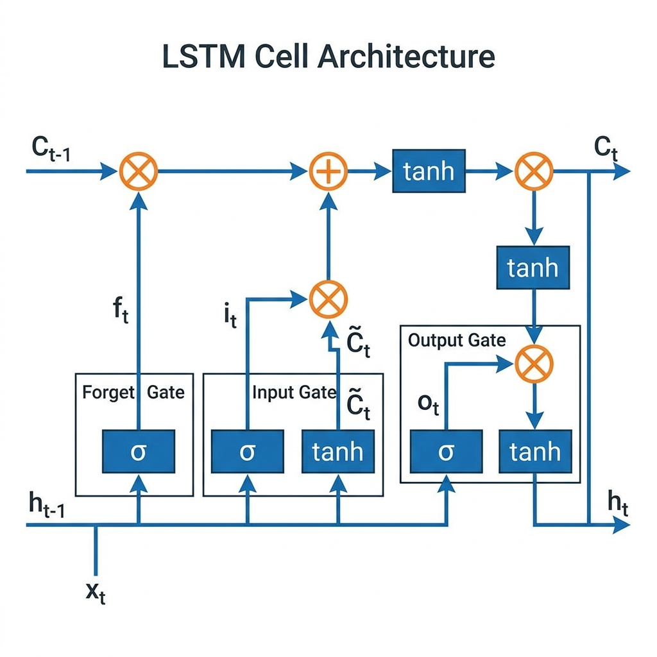
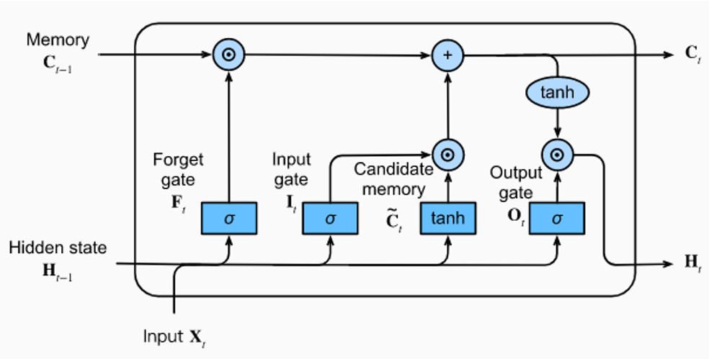
LSTM — Long Short-Term Memory Networks
LSTM is a type of Recurrent Neural Network designed to learn
long-term dependencies in sequential data. It solves the vanishing
gradient problem that affects standard RNNs.
Three gates control information flow:
• Forget Gate: decides what to discard from memory
• Input Gate: decides what new information to store
• Output Gate: decides what to output as prediction

Slide 13
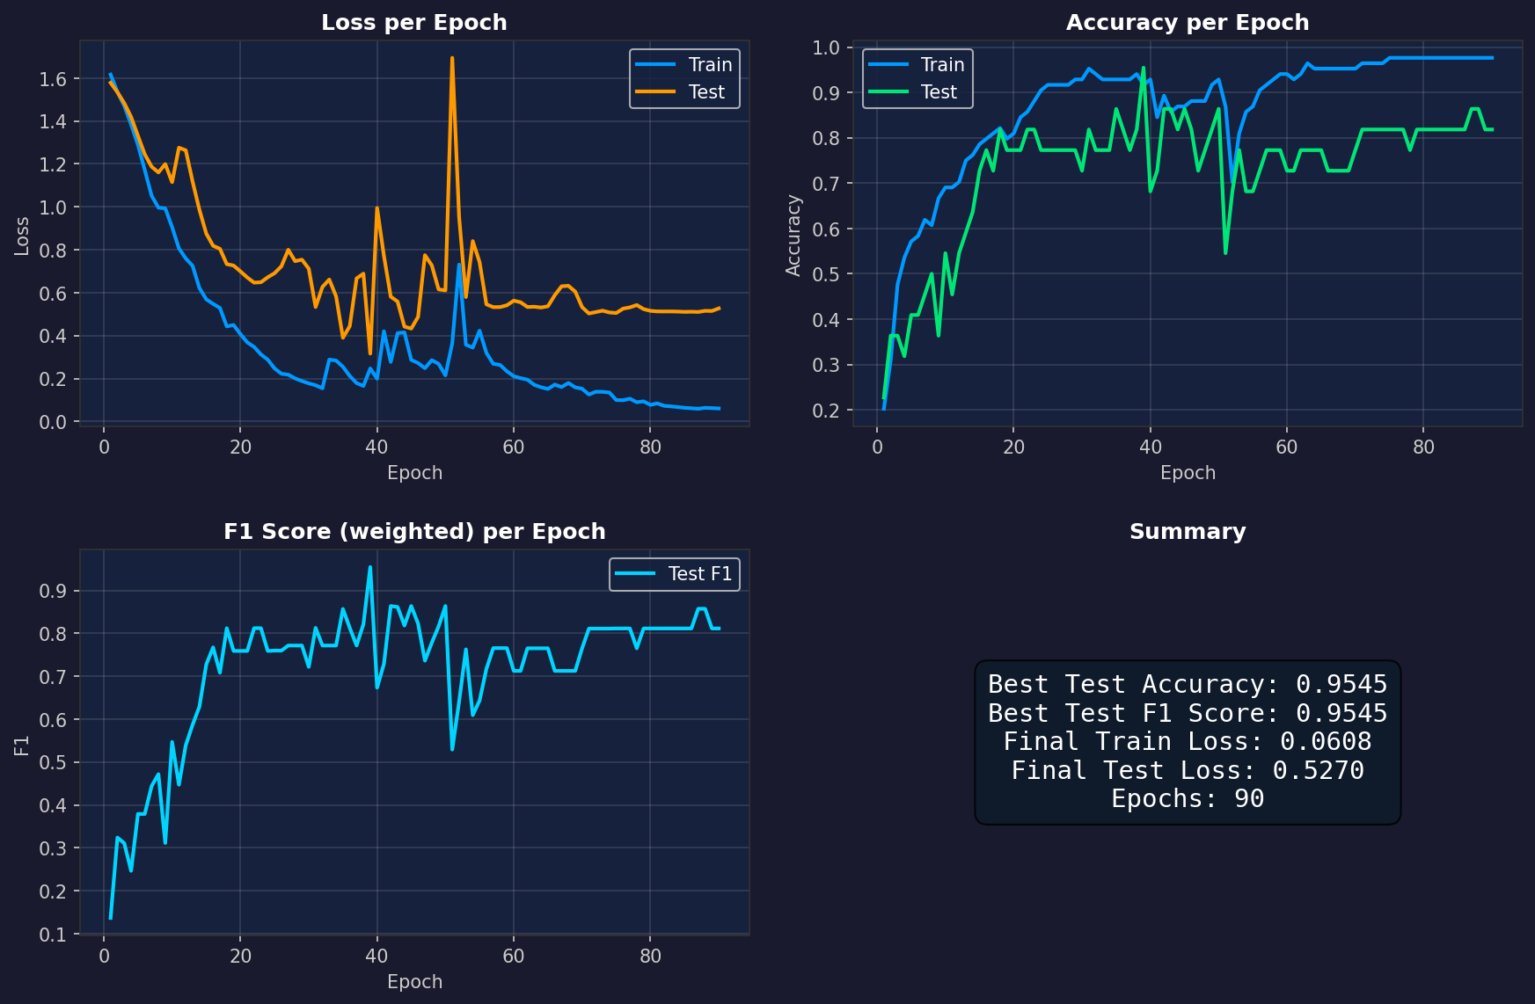
Model 1: 6 Raw Inputs
Raw accelerometer (ax, ay, az) + gyroscope (gx, gy, gz)
No normalization applied.
Input shape: [N, 300, 6]
Best Accuracy: 95.45% | Best F1: 0.9545

Slide 14
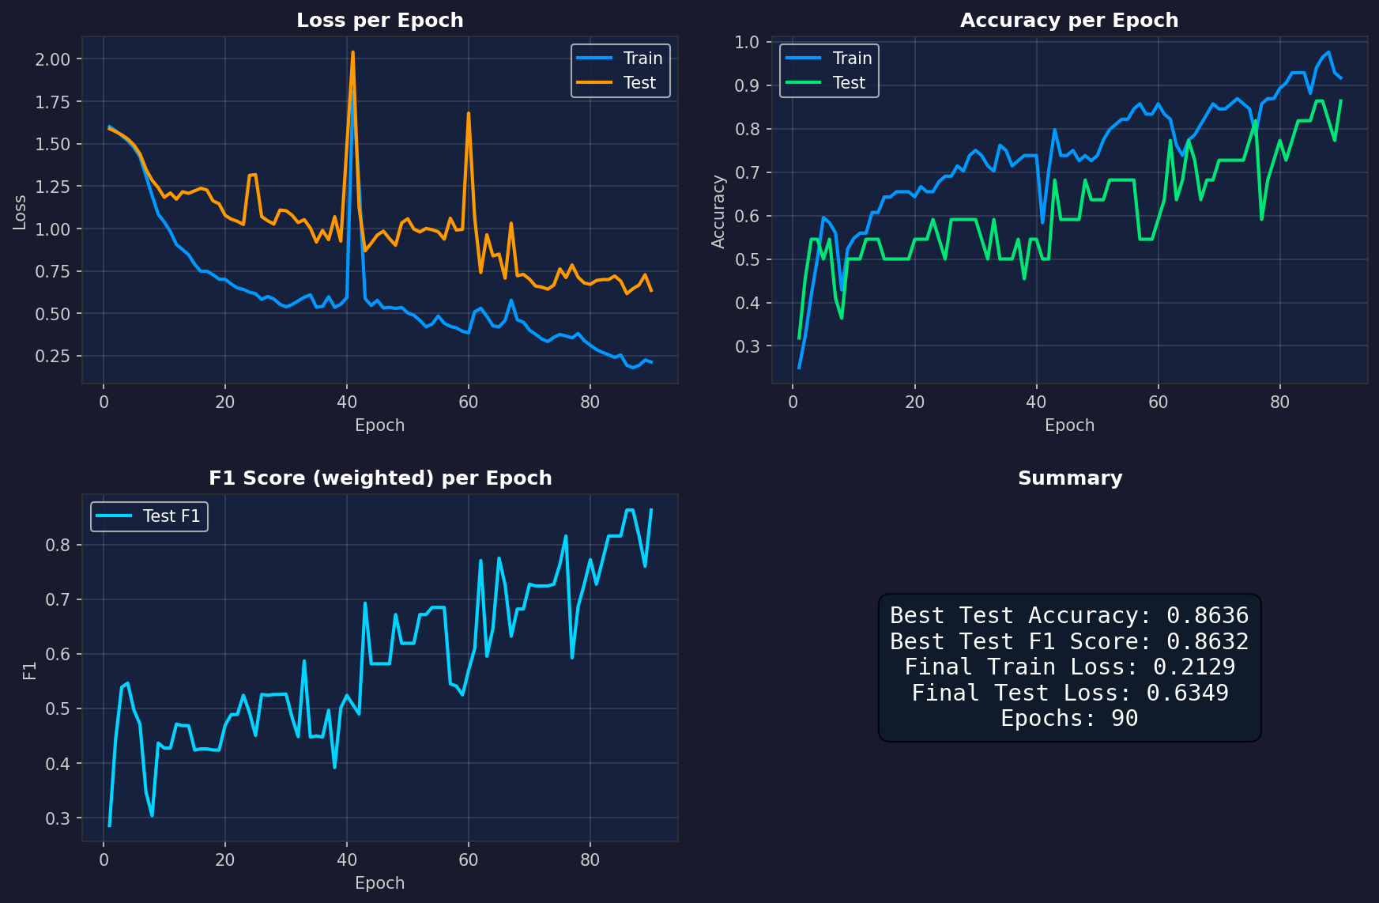
Model 2: 6 Normalized Inputs
Same 6 channels with z-score normalization
(per-feature mean/std from training set).
Input shape: [N, 300, 6]
Best Accuracy: 86.36% | Best F1: 0.8632

Slide 15
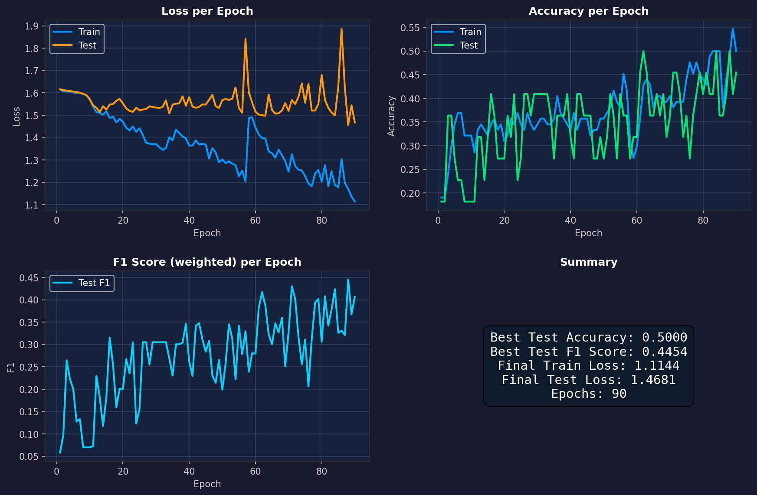
Model 3: 4 Madgwick Quaternions
Madgwick filter applied to raw IMU data
Outputs quaternion orientation (q0, q1, q2, q3).
Input shape: [N, 300, 4]
Best Accuracy: 50.00% | Best F1: 0.4454

Slide 16
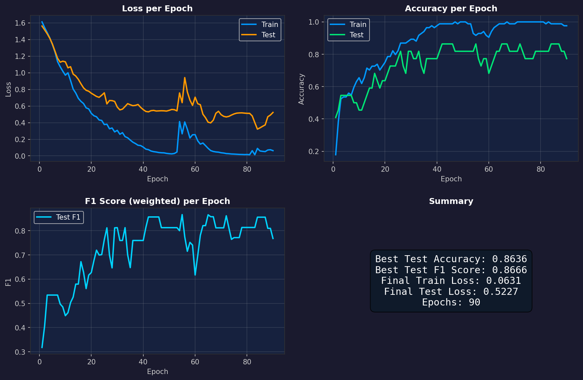
Model 4: 10 Raw Inputs
Concatenation of 6 raw channels + 4 quaternion channels.
No normalization.
Input shape: [N, 300, 10]
Best Accuracy: 86.36% | Best F1: 0.8666

Slide 17
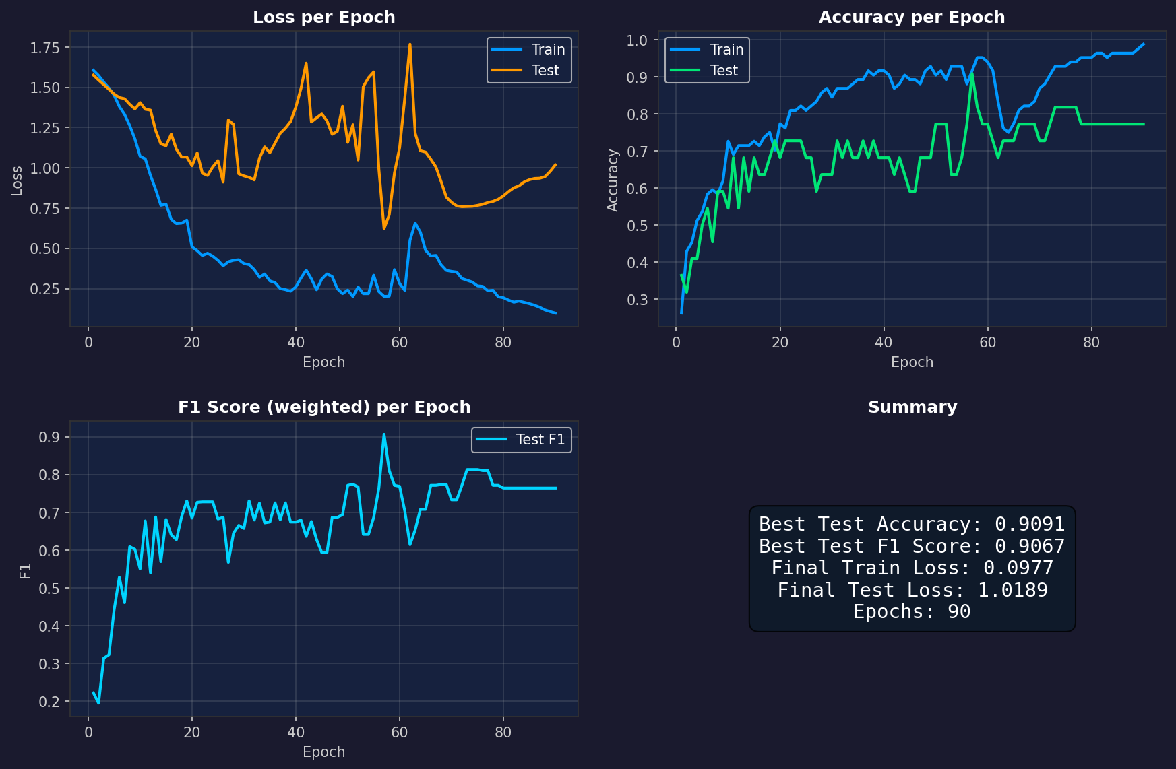
Model 5: 10 Normalized Inputs
Same 10 channels with z-score normalization.
Input shape: [N, 300, 10]
Best Accuracy: 90.91% | Best F1: 0.9067

Slide 18
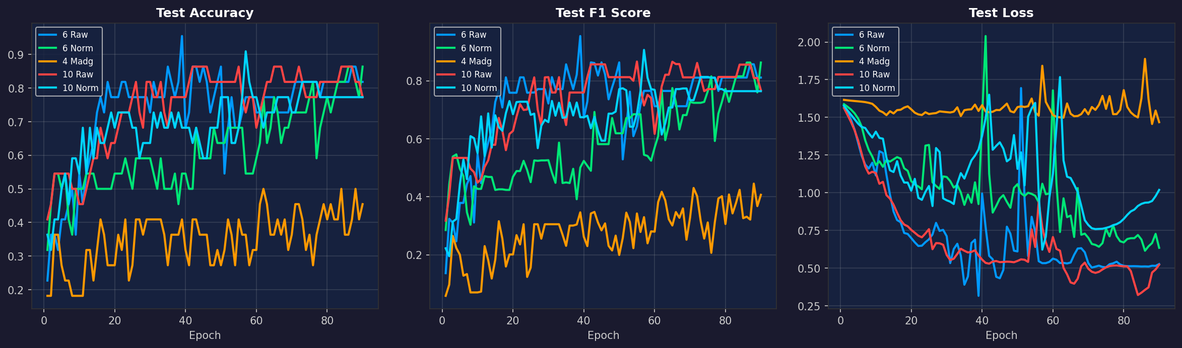
Model Comparison Summary
Model | Input Dim | Norm | Best Acc | Best F1 | Final Loss
6 Raw | 6 | No | 0.9545 | 0.9545 | 0.0608
6 Norm | 6 | Yes | 0.8636 | 0.8632 | 0.2129
4 Madg | 4 | No | 0.5000 | 0.4454 | 1.1144
10 Raw | 10 | No | 0.8636 | 0.8666 | 0.0631
10 Norm | 10 | Yes | 0.9091 | 0.9067 | 0.0977

Slide 19
Advantages & Use Cases
Advantages:
• Low-cost hardware (ESP32 + MPU sensor < $10)
• Real-time inference capability
• Wireless operation via Bluetooth
• Non-vision based — works in any lighting condition
• Portable and lightweight design
• Extensible gesture vocabulary
Use Cases:
• Accessibility — assistive input for motor-impaired users
• Sign Language Translation — real-time text conversion
• Virtual Reality — natural hand interaction in VR environments
• Remote Control — gesture-based device control
• Gaming — motion-controlled game input
• Industrial — hands-free equipment control
• Medical Rehabilitation — tracking patient hand recovery

Slide 20
References
[1] InvenSense, "MPU-9250 Product Specification," TDK Corp., Rev 1.1, 2016.
[2] S. Madgwick, "An efficient orientation filter for inertial and inertial/
magnetic measurement units," Report, University of Bristol, 2010.
[3] S. Hochreiter & J. Schmidhuber, "Long Short-Term Memory,"
Neural Computation, vol. 9, no. 8, pp. 1735-1780, 1997.
[4] Espressif Systems, "ESP32 Technical Reference Manual," v5.3, 2024.
[5] MDPI Sensors, "Sensor-Based Sign Language Recognition Using
Bidirectional LSTM Networks," 2022.
[6] IEEE Access, "EWBiLSTM-ATT: CNN + BiLSTM with Attention
for Dynamic Gesture Recognition," 2023.
[7] PLoS ONE, "CNN-BiLSTM Architecture for Wearable Gesture
Recognition," 2023.
[8] IEEE Sensors Journal, "Para-LSTM-CNN: Parallel Spatial-Temporal
Feature Extraction for IMU Gesture Data," 2022.

